Slide 2
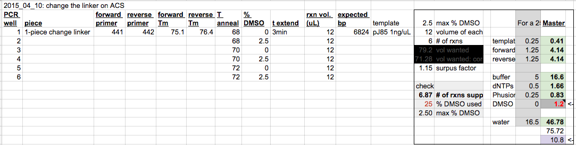

Slide 3
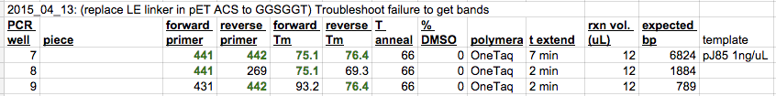
I added the Midori Green DNA dye directly to the tube, which I believe caused the smear.
The point is that the two primers work individually.
These primers are not suitable for the extension, but I showed today that

Slide 4
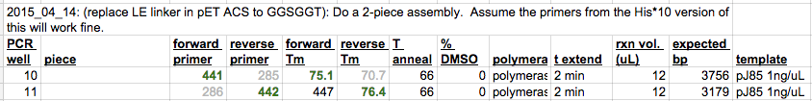
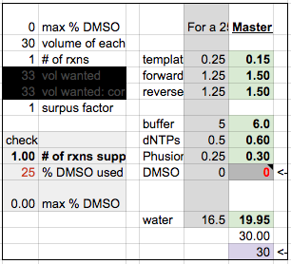

Slide 5
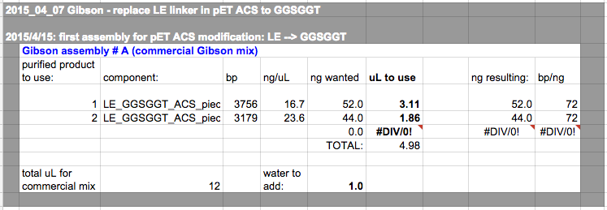
Transformed once 4/14, then desalted and re-transformed 4/16. Gave 3 colonies to screen.

Slide 6
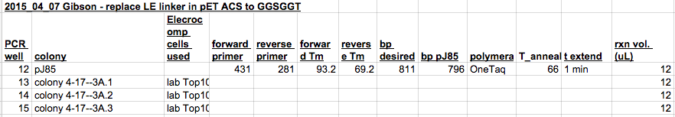
2015_04_20 pic:
+ control
3A-2

